Slide 1
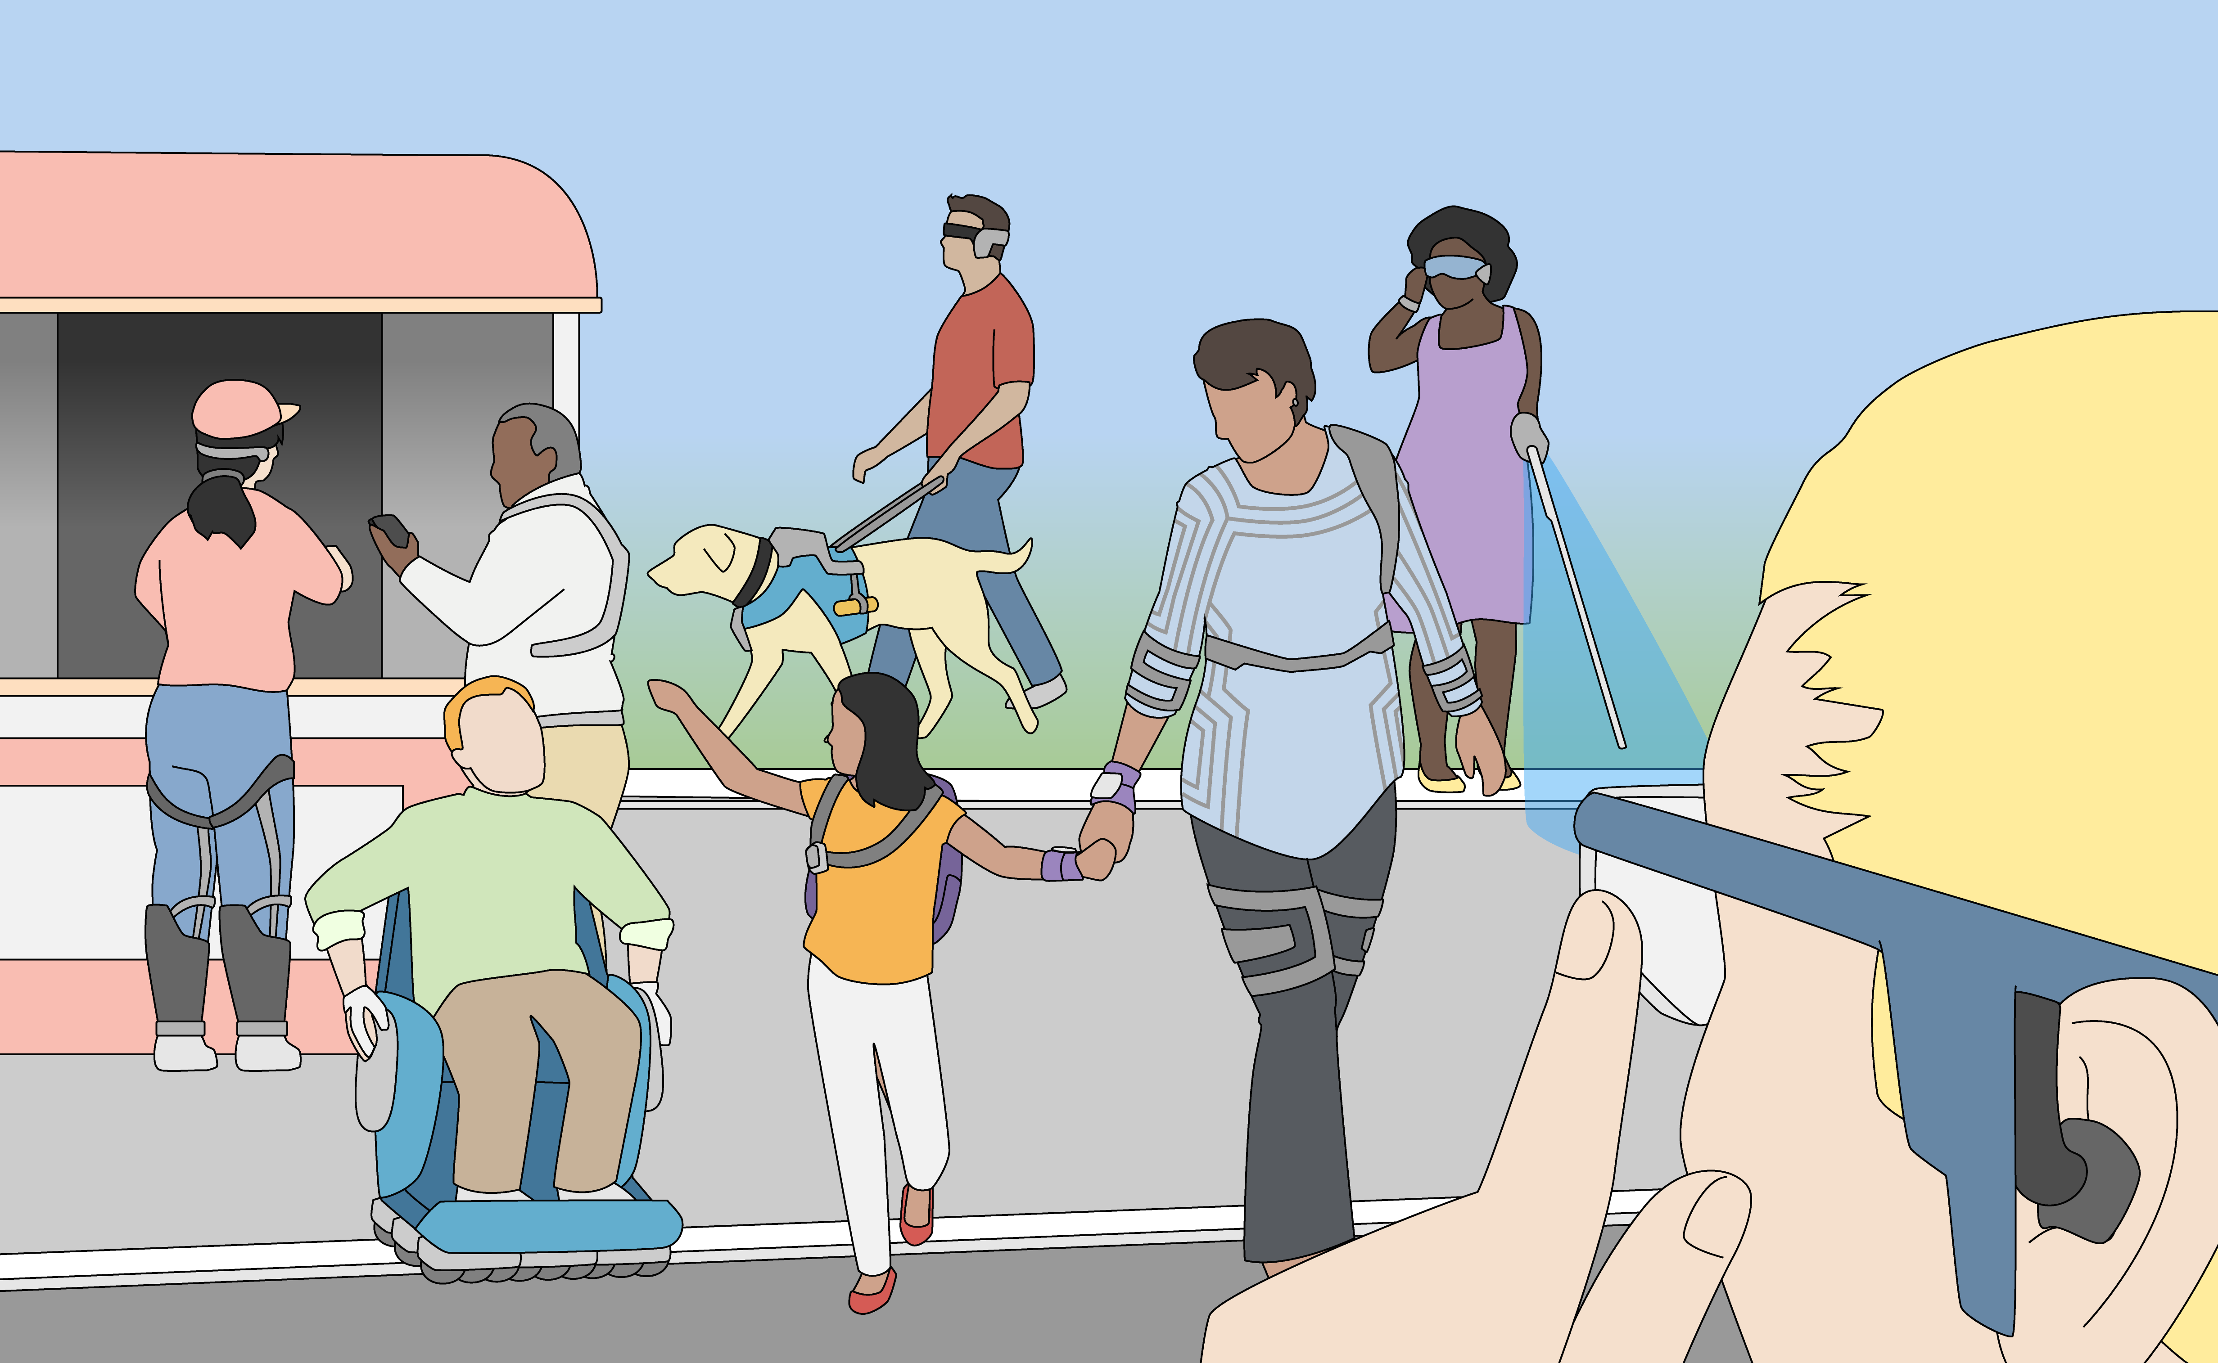
Maribeth Gandy
User-centered Design of
Mobile & Wearable Applications

Slide 2
Definition of User-Centered Design
“…the process of designing a tool, such as a website’s or application’s user interface, from the perspective of how it will be understood and used by a human user.”
“…tries to optimize the product around how users can, want, or need to use the product, rather than forcing the users to change their behavior to accommodate the product.”
Guiding principles
Start with the users rather than the technology or even solutions
Consider all the stakeholders
System must provide immediate value to the user
Wearable (and mobile) systems must mesh with the users environment, culture, and lifestyle.
And should support users doing a primary task separate from application
For what kind of research is this field helpful?
Systems meant to be integrated into existing workflows, lifestyles, communities, and environments
Who are the experts?
Human Computer Interaction (HCI) Experts come from a variety of disciplines
Computing, Engineering, Psychology, Sociology, and Design

Slide 3
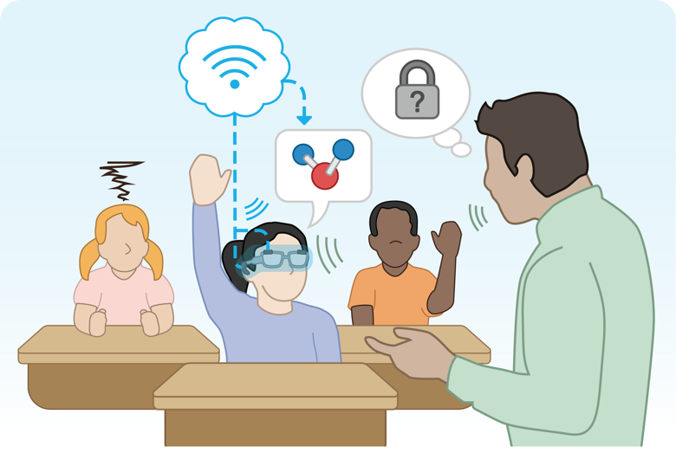
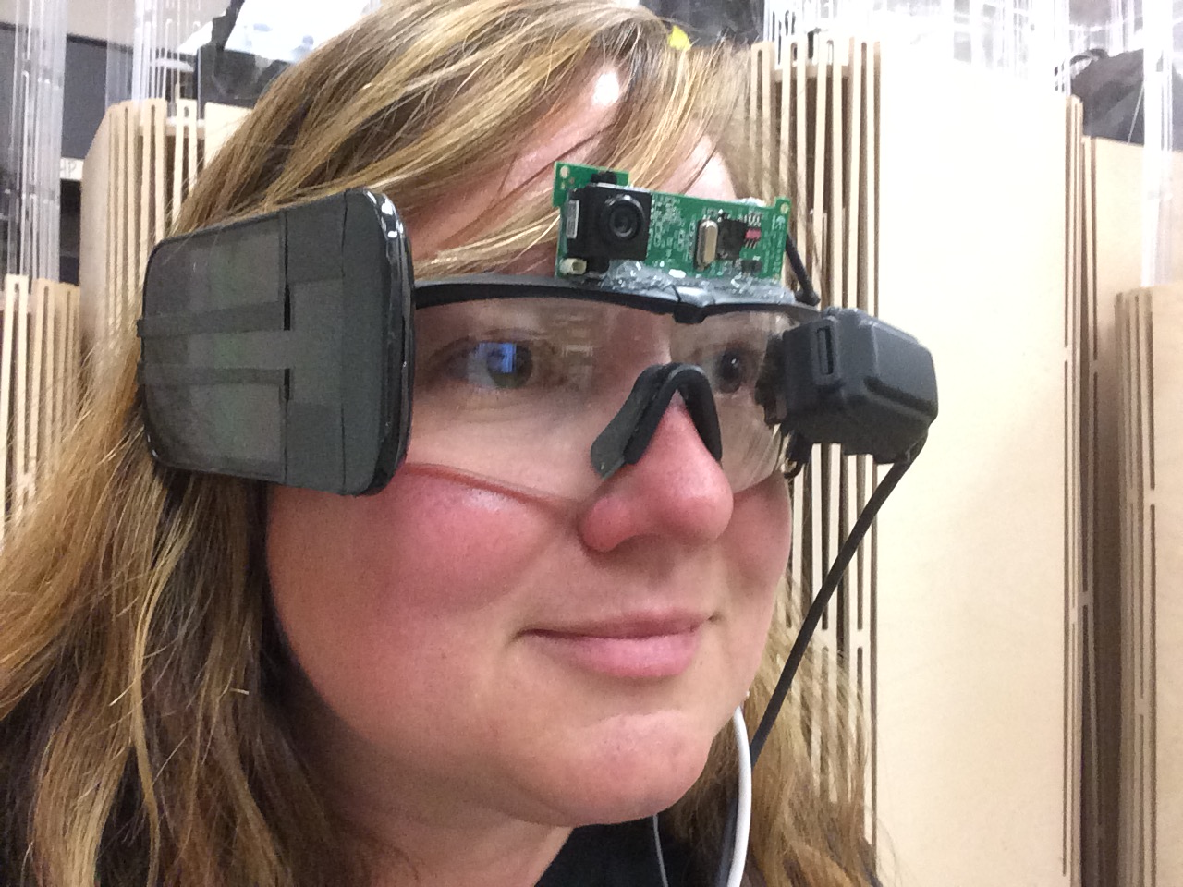
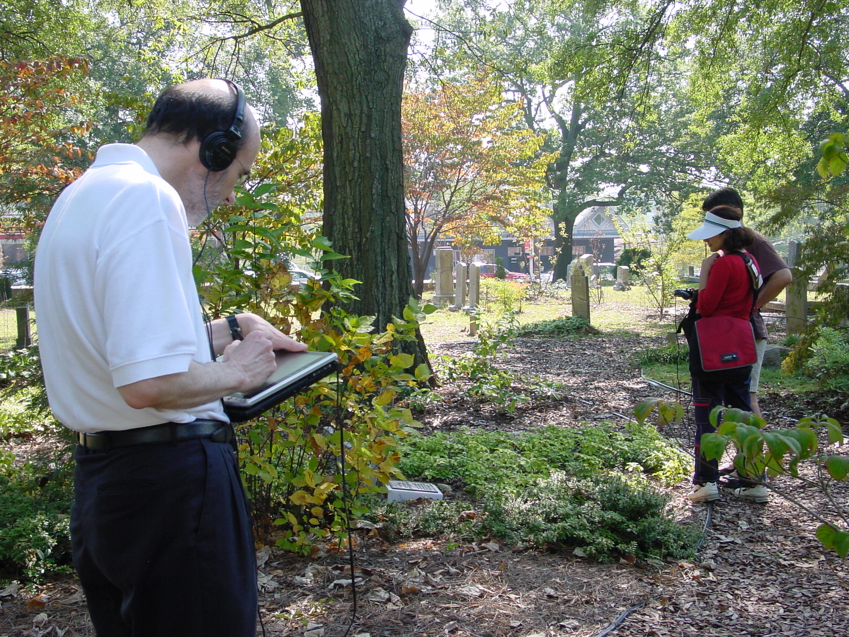
Guiding Principles and Key Terms
The Process and Keywords
Futures-based Approach
Extended Present, Familiar Future, Unexpected Futures
Disregarded signals
Consensus is not the goal
Participatory Design
focused on collaborative decision-making
moving end-users into world of researchers. Empathic Design moves researchers into world of end users.
Prototyping
In situ ideation (e.g. DART)
Low fidelity for ease and to garner the best feedback
Google Glass
Wizard-of-Oz techniques can be used to produce systems with realistic behavior with little development required
“Voices of Oakland”
Notes:
Ethnography: Tech may be used mobile AR study that used app to query person throughout day. Don’t focus on particular technology
Personas & Scenarios: use in assistive technology research, Wireless RERC user surveys turned into personas. Represent the target users. Often good in situations where researchers are quite different from the target. Can be applied to communities too, Sherwood Glen community also useful in civic computing. Story of use of Sherwood Glen to brief researchers on work to be done in Atlanta.
Prototyping: low fidelity get more significant feedback, Google Glass made out of mobile phones. WOZ study of voice assistant with Thad (valuable data from users as well as from “Wizards”)
Iterate:
Summative Evaluation: longitudinal needed, especially for health outcomes. What happens when novelty wears off…or when effect is reduced over time? Voice Analysis via the Phone

Slide 4
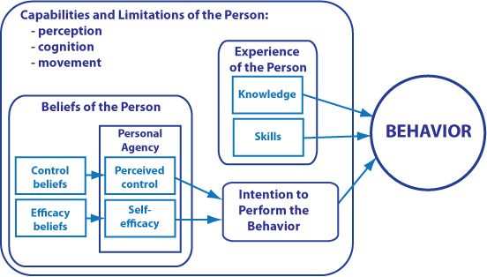
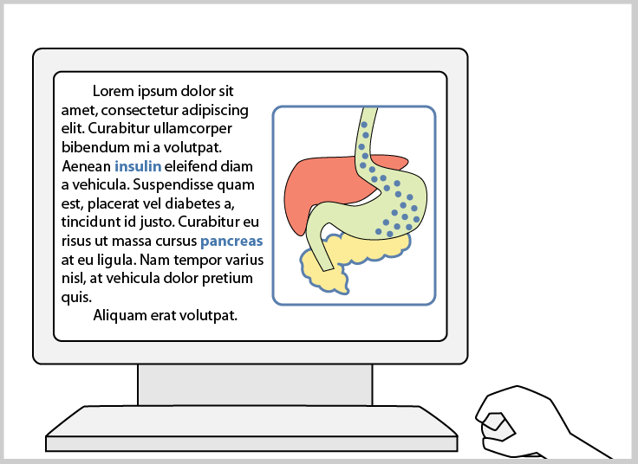
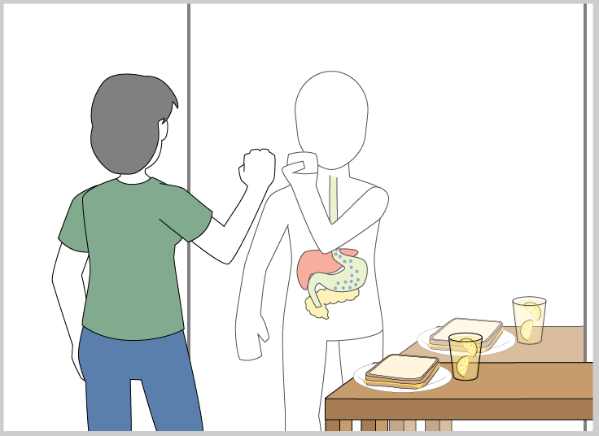

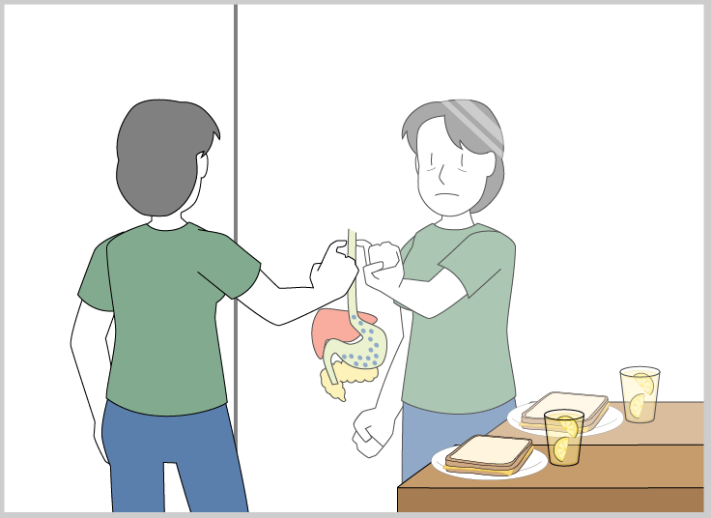
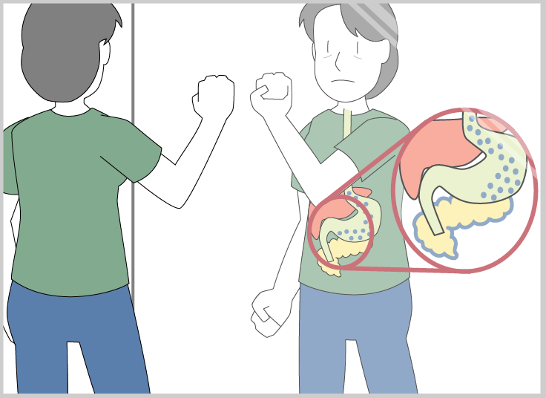
Consider the Context
First step is awareness, but there is a large jump to positive behavior change
Sensing/measures/logging -> producing insights/presenting data -> sensemaking-> guiding toward effective strategies
Lifemash, Diabetes Detective, Voice Stress Analysis
Adherence is the challenge. Novelty/motivation fades
Social considerations. Users may be self-conscious
Wearable touchpad design
Make the user experience positive rather than negative

Slide 5
Consider the Context: an assistive technology device
How to provide situational awareness to a user with vision impairment?
Participatory design with all stakeholders
in vivo versus in vitro design
Guide dog as inspirational “technology”
Convention, Public Policy, and Regulation
Requirements
Controllable conspicuousness
Technology as “ice breaker”
Avoid information overload
Transparency of sensing & mode

Slide 6
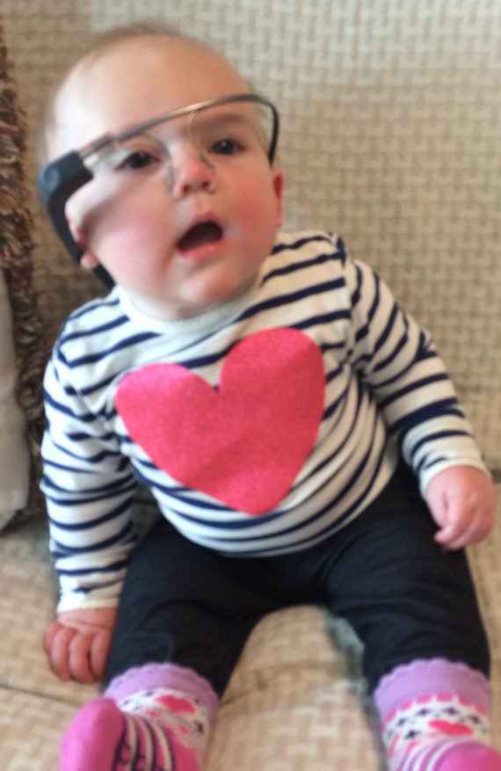
Dimensions of Design: Elements of the user experience
Results from early user-centered design activities help you tune the following parameters
Physical Parameters and Wearability
Size, weight, battery life, heat produced, body placement
Conspicuousness & Aesthetics
Fashion, community norms, hide or flaunt the technology?
Social Conventions
What is considered “normal”, “cool”, “weird” etc. in this community?
Context of Use
Users will accept inconvenience, privacy reduction, discomfort etc. for substantive value
Who, What, When, Where, Why
Privacy & Security
Transparency of system and awareness on part of user are critical
Observers’ Experience
How do others experience and perceive this system/device?
Sensory Requirements
Cognitive and sensory demands of use (e.g. attentional demands, occlusion of visual field, use of auditory frequency spectrum, space taken up on the body)?
Often must evaluate system in situ
Regulation and Legislation
ADA, FCC, HIPAA
Notes:
Physical Parameters: Gemperle, et al. lay out certain physical guidelines for designing technology for wearability [13]. These guidelines become even more important when viewed through the lens of policy. Designing for physical wearability with an eye towards accessibility should be a goal of any good wearable device. This means that weight, heat, and body placement matter, especially when designing devices for people with disabilities, the aging, and other populations with functional limitations [14].
Context of Use: As mentioned above, much of the cultural acceptance of of a wearable device is related to its context of use. A device used by an authority figure may seem more threatening or intrusive, conversely, a conspicuous technology that is providing assistance to a person with a disability may be perceived as less intrusive by people around the wearer, and people may accept less privacy from wearable sensors if they provide measurable wellness or lifestyle benefits.
Privacy and Security requirements. Concern over the privacy and security of data is arguably the leading issue surrounding current wearable technology policy and legislation. The use of the Google Glass device in public places has resulted in many wearers being banned from locations such as movie theaters, restaurants, and even the Google shareholder meeting due to the presence of a point-of-view camera [15]. The expectations of privacy and security are highly influenced by the context of use. For example Halderman et al. discussed how mobile picture taking can be viewed very differently even in the same location: a recording in an office meeting could considered be a useful record or an invasion of privacy depending on the context [16]). Similarly, users willingly accept potential loss of privacy if the utility of the technology is sufficiently compelling. A concern in this case is whether wearable users are indeed aware of the degree and amount of information they may be trading for convenience.
Conspicuousness: As technology has become mobile and now becomes part of our physical bodies via wearables, an important design decision is how conspicuous the technology should be. How noticeable is the device to an observer? In the past the wearable designer might have aimed to make the technology disappear. In the case of an assistive device the approach may be welcome by the target user, as she may not wish to advertise her disability. Conversely, the public (or the authories) may desire for such technologies to be noticeable so that those around a wearable user can be aware of what technologies are present and/or in-use.
Observers’ experience: When designing a new device we tend to focus on the user experience, but how people surrounding the user experience and perceive the technology can be very important as well [18]. Our societal response to increased mobile phone use in public over the past decade reveals how technologies that disrupt the environment or cause users to behave in unexpected ways can lead to an increased need for new social norms, as well as additional public policy and legislation. Our society will change in unpredictable ways in response to these wearable technologies, but the designer must attempt to consider how a wearable device will be experienced by everyone in the environment or risk social or legal rejection of the technology.
Sensory Requirements. With previous technologies such as the television and the personal computer, a designer could assume that the user’s primary focus would be on the device during use. However, a wearable device is often used to support the user during a different primary task (e.g. working out at the gym, giving a presentation, driving, crossing the street etc.). Therefore, the designer must consider the demands a device will place on the user cognitively and how much of the user’s sensory bandwidth will be consumed by the interface (e.g. occlusion of visual field, use of auditory frequency spectrum, space taken up on the body). Evaluations of wearable devices should ideally be in situ (or a properly outfitted lab environment) [19] and should study use in parallel with appropriate parallel activities (e.g. navigating physical space [20], carrying on a conversation [21], or performing a motor task [22]). It is critical to minimize the sensory demands of a wearable and/or understand the effects that use have on the wearers’ capabilities such that the device will be designed for safe usage and policies can be constructed that protect users (and those around him) from harm (e.g. see the debates, scientific research, and resulting laws related to text messaging while driving).
Design also operates by taking into account the (mis)use of the device as it interacts with social/cultural context. There are three ways that a new technology can be “controlled” such that negative effects are avoided. These include: designing for intended use, the pressure of social conventions, and the implementation of standards, legislation, and regulation.
Designing for proper/intended use. The first step [15] should be designing a device so it attempts to make malicious/undesired use difficult, if not impossible. This includes restricting re-programming (e.g. “rooting” or “jailbreaking”) of a device, reducing the ability of users to modify or personalize the device. However, this can be a heavy handed approach that limits functionality or alienates users. An open platform makes the inner-workings of the system transparent (allowing the community to analyze, comment on, and possibly fix problems and security vulnerabilities), but will also encourage applications developed by third parties that were not originally conceived by the original designer. The restriction philosophy is analogous to a governor on a car that simply does not let you go over the speed limit, versus a more elegant, albeit less certain, approach where the gas pedal increases physical resistance to your foot as speed increases. Neither approach is “correct” but is determined by the context of use, the vulnerability of the user and the information, and the severity of outcomes resulting from misuse.
Social conventions. The next defense against misuse is designing for and leveraging social convention. The designer must explore and hypothesize about how a device will be used in and perceived by society, envisioning the user experience in a way that the proper use is socially acceptable and/or undesired uses will be discouraged by social mores. For example, we have already discussed the negative feedback Google has received for the Glass camera, but to take a picture a Glass wearer must either reach up and touch the side of the display or speak the phrase “Glass, take a picture.” In both cases the eye display is lit and the user must have his face turned toward the subject of the picture. Openly staring at someone, while vocalizing, or making an obvious gesture, with a brightly light over one’s eye, is actually a relatively conspicuous interaction that, some would argue, is sufficiently noticeable that users would be discouraged by social rules from taking pictures in a privacy violating manner.
Regulation and Legislation. Historically changes to devices were made after the fact either to bring them into compliance with a changed regulatory environment, or to add needed functionality to devices. Wearables, particularly those that communicate externally are regulated under several different standards, depending on the facet under discussion. Data flow over radio waves in the U.S. is regulated by the Federal Communications Commission (FCC), which is concerned not just about the radio emissions of the device per se, but potential interference with other uses in the vicinity. However, this is generally a consideration that designers have long been familiar with. Less familiar may be the requirements that under the Americans with Disabilities Act, that cover web accessibility, as a special case of a public accommodation. It is not impossible to imagine, and hence to anticipate that wearable interfaces will also be required to be accessible to people with disabilities. Murkier issues surround what could be said to fall between specifically mandated regulation and law created as a consequence of legal cases brought to remedy condition such as perceived (or real) violations of privacy, negligence in the handling of data flow between devices, as well as potential challenges to generally accepted social conventions not currently regulated as technology is ahead of application. Here, the value of the approach of instituting teams of designers, technologists, policy specialists and end users, becomes apparent in the adoption of proactive policy design and standards.

Slide 7

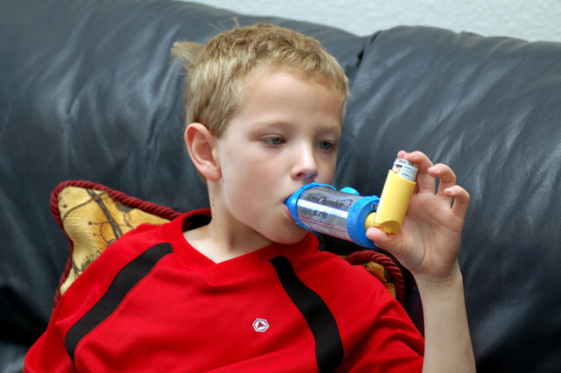
Case Studies: Lessons Learned (Health)
Wearable systems require considering all aspects of the user experience
Asthma Management for Kids: Jeong, H., Sung, J., Yun, T., and Arriaga, R.I. (2011) A user-centered approach to support ubiquitous healthcare for pediatric chronic illness: Asthma as a case study. Proc. of IASDR 2011
kidshealth.org/parent/medical/lungs/teen_asthma.html
forums.webmd.com/3/asthma-exchange/forum/1973/9
Consider community (geography and culture)
Nutrition in Food “Deserts”: Andrea Grimes, Vasudhara Kantroo, and Rebecca E. Grinter. 2010. Let's play!: mobile health games for adults. In Proceedings of the 12th ACM international conference on Ubiquitous computing (UbiComp '10). ACM, New York, NY, USA
Nudge the user toward good choices
Peripheral Display of Nutrition Information: Chhabra, J., Singh, J., Baquero, D.S. (2008). Abstracting nutritional information of food service facilities using the Pervasive Healthy Diet Adviser. Proceedings of the International Conference on Smart Home and Health Telematics (ICOST 2008).
One approach does not work for all users or conditions
SMS for Asthma: Yun, T. & Arriaga, R. I., A Text Message a Day Keeps the Pulmonologist Away. Proceedings of the ACM SIGCHI Conference on Human Factors in Computing Systems (CHI 2013), May 2013
SMS for Heart Disease: Teresa Lyle, Wendy Book, Rosa Arriaga, Joanie Jackson, SMS Heart Text Messaging Intervention: A Tool for Enhancement of Self-Care and Symptom Awareness in Adults with Congenital Heart Disease
Perceived value and comfort are relative
Wearable device for workers: Daniel P. Siewiorek, Asim Smailagic, Thad Starner, Application Design for Wearable Computing, Morgan & Claypool Publishers, 2008, Computers, 65 pages
Don’t be a technology “hammer” looking for an application “nail”
Breast Pump Hackathon: breastpump.media.mit.edu

Slide 8

Lessons Learned
Gestural Interface for AR Presentation
People with lots of body language break it
Wearable Instrument Performance
The value of real co-design (designers, technologist, performer)
Artist faced debugging challenges
Rob’s 4590 project
https://youtu.be/D69ZluasFWM
How much training is required?
What do users do when they first interact?
Well-designed pitch control interface
Food for thought
How does it fail?
Characterize the technology error rate, performance, etc.
What extra work is needed for robustness
How is it learned and how much training is required
How will they know what to do? (Gesture Pendant)
How is interaction perceived by onlookers

